Slide 1
COMMENT JUSTICE
Cyber Security webpage

Slide 2
Our Members
How to use the website?
01
04
Our Target
02
05
Is it an incomplete project?
What does the website do?
03
06
About Technica
How we work collaboratively?
Brief instructions on how the website works
What we are looking for when doing this project
Discuss on what we haven’t covered
Our basic goal when making the website

Slide 3
01
Our Team

Slide 4
Our team member
Emm McCee
Huyen Pham
Melissa Gatti
Valeria Cerpa Salas

Slide 5
02
Our Target

Slide 6
PROBLEM VS. SOLUTION
Problem
People are too open online.
➔Share excessive information that can potentially be harmful.
Notes:
Nowadays, with the development of Social Media, we are becoming much more open. We tend to share things that are personal too easy. I bet some of you have used your real name as a social media name, or gave your real birthday to Facebook.

Slide 7
530,000,000
Estimated total amount
Notes:
Believe it or not, based on BBC News last year, around 530 million Facebook users got their data leaked. They sell our data, but not always to good people.

Slide 8
PROBLEM VS. SOLUTION
Problem
People are too open online.
➔Share excessive information that can potentially be harmful.

Slide 9
PROBLEM VS. SOLUTION
Problem
Solution
People are too open online.
➔Share excessive information that can potentially be harmful.
Our goal
Notes:
So, the solution is our aim, we aim for making something to protect the users’ data.

Slide 10
OUR TARGET
COMMENT JUSTICE
- Our goal is to raise social media users’ awareness of how they use their personal information.
Notes:
But first, before having any kind of advanced machine to protect us, we need to be self-aware.

Slide 11
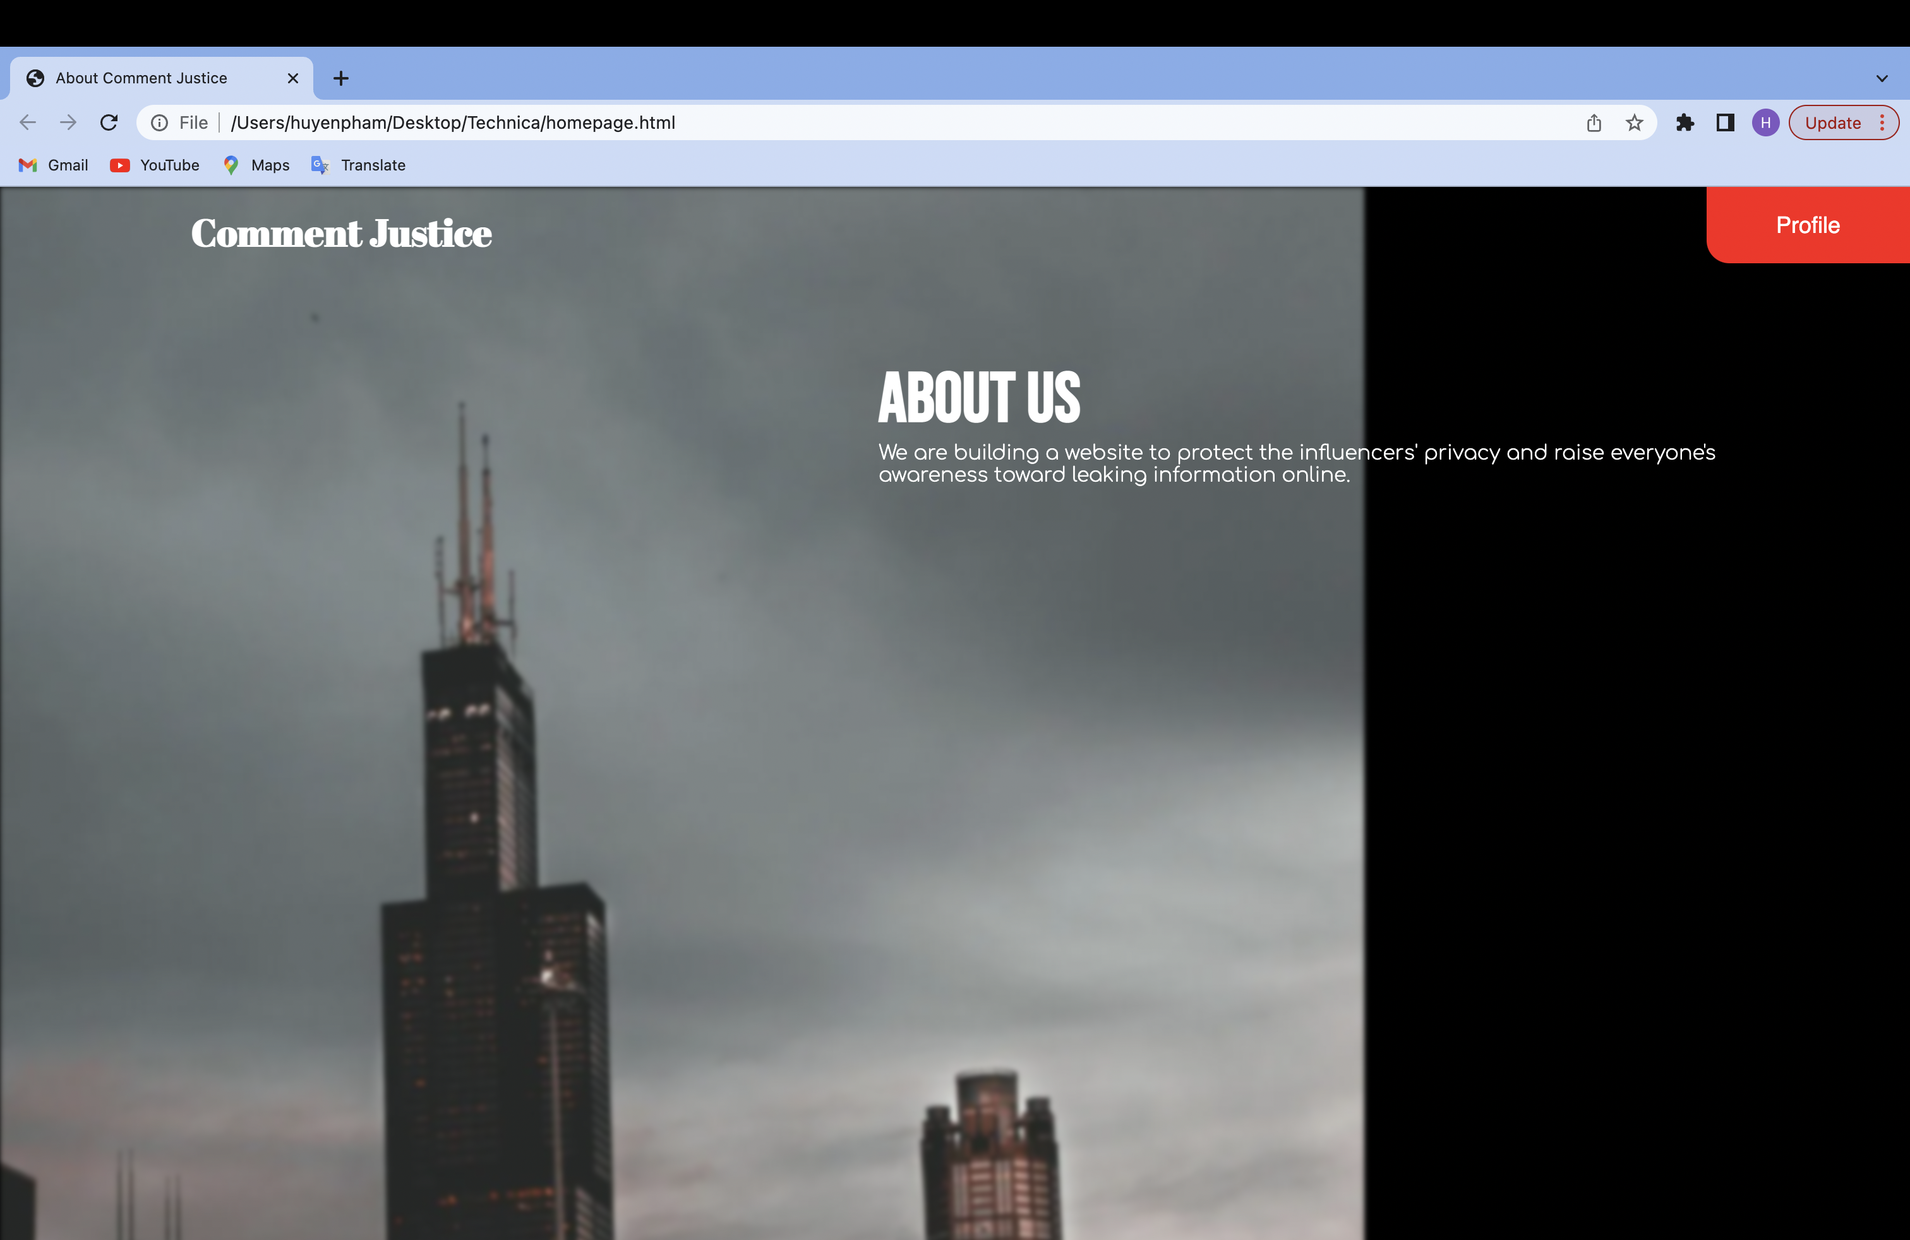
Our website
Notes:
And to achieve that, in this project, we are building a website.

Slide 12
03
Website’s purpose

Slide 13
PURPOSE
First part
Second part
Provides user information about Instagram influencers.
If the user uses their personal information in a comment, it will send an alert.
Notes:
For this project, there are 2 parts. The first part is providing the users data on the Instagram influencers. The second part is when it’s getting interesting. We will ask the user to type in their comment and if they use any of the influencers’ information, it will be game over for them.

Slide 14
04
WEBSITE INSTRUCTION

Slide 15

HOMEPAGE

Slide 16
HOMEPAGE

Slide 17
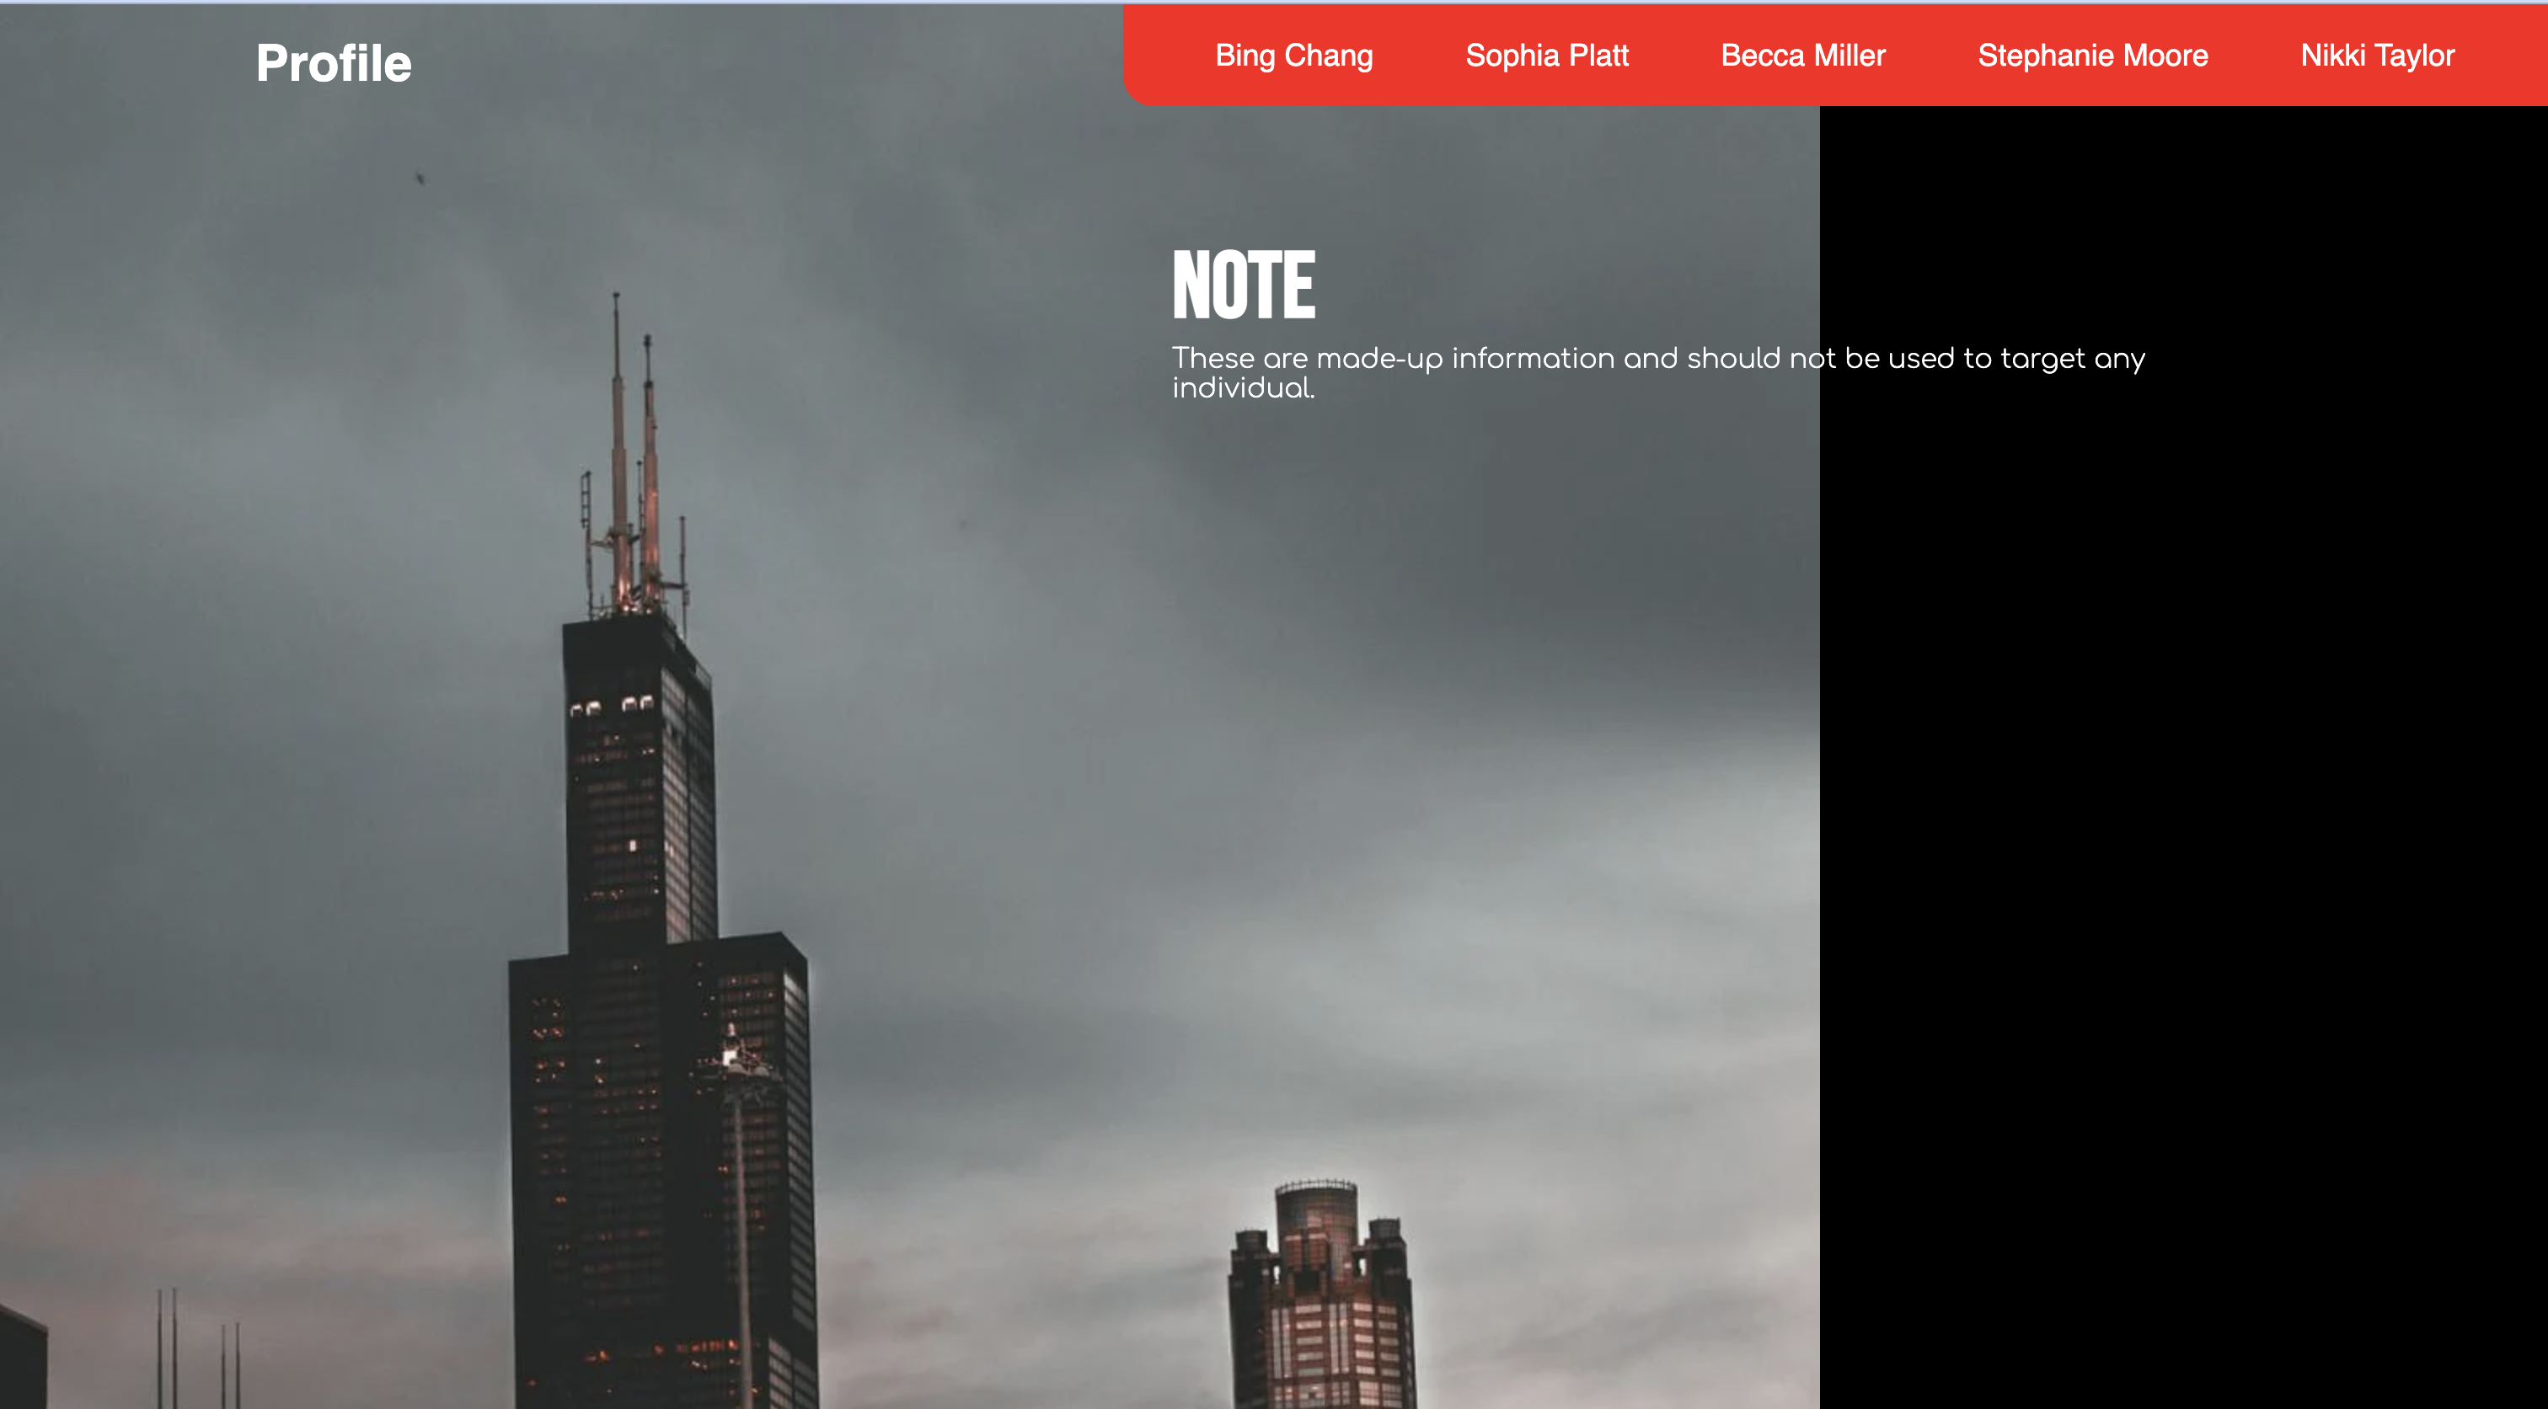
PROFILE

Slide 18
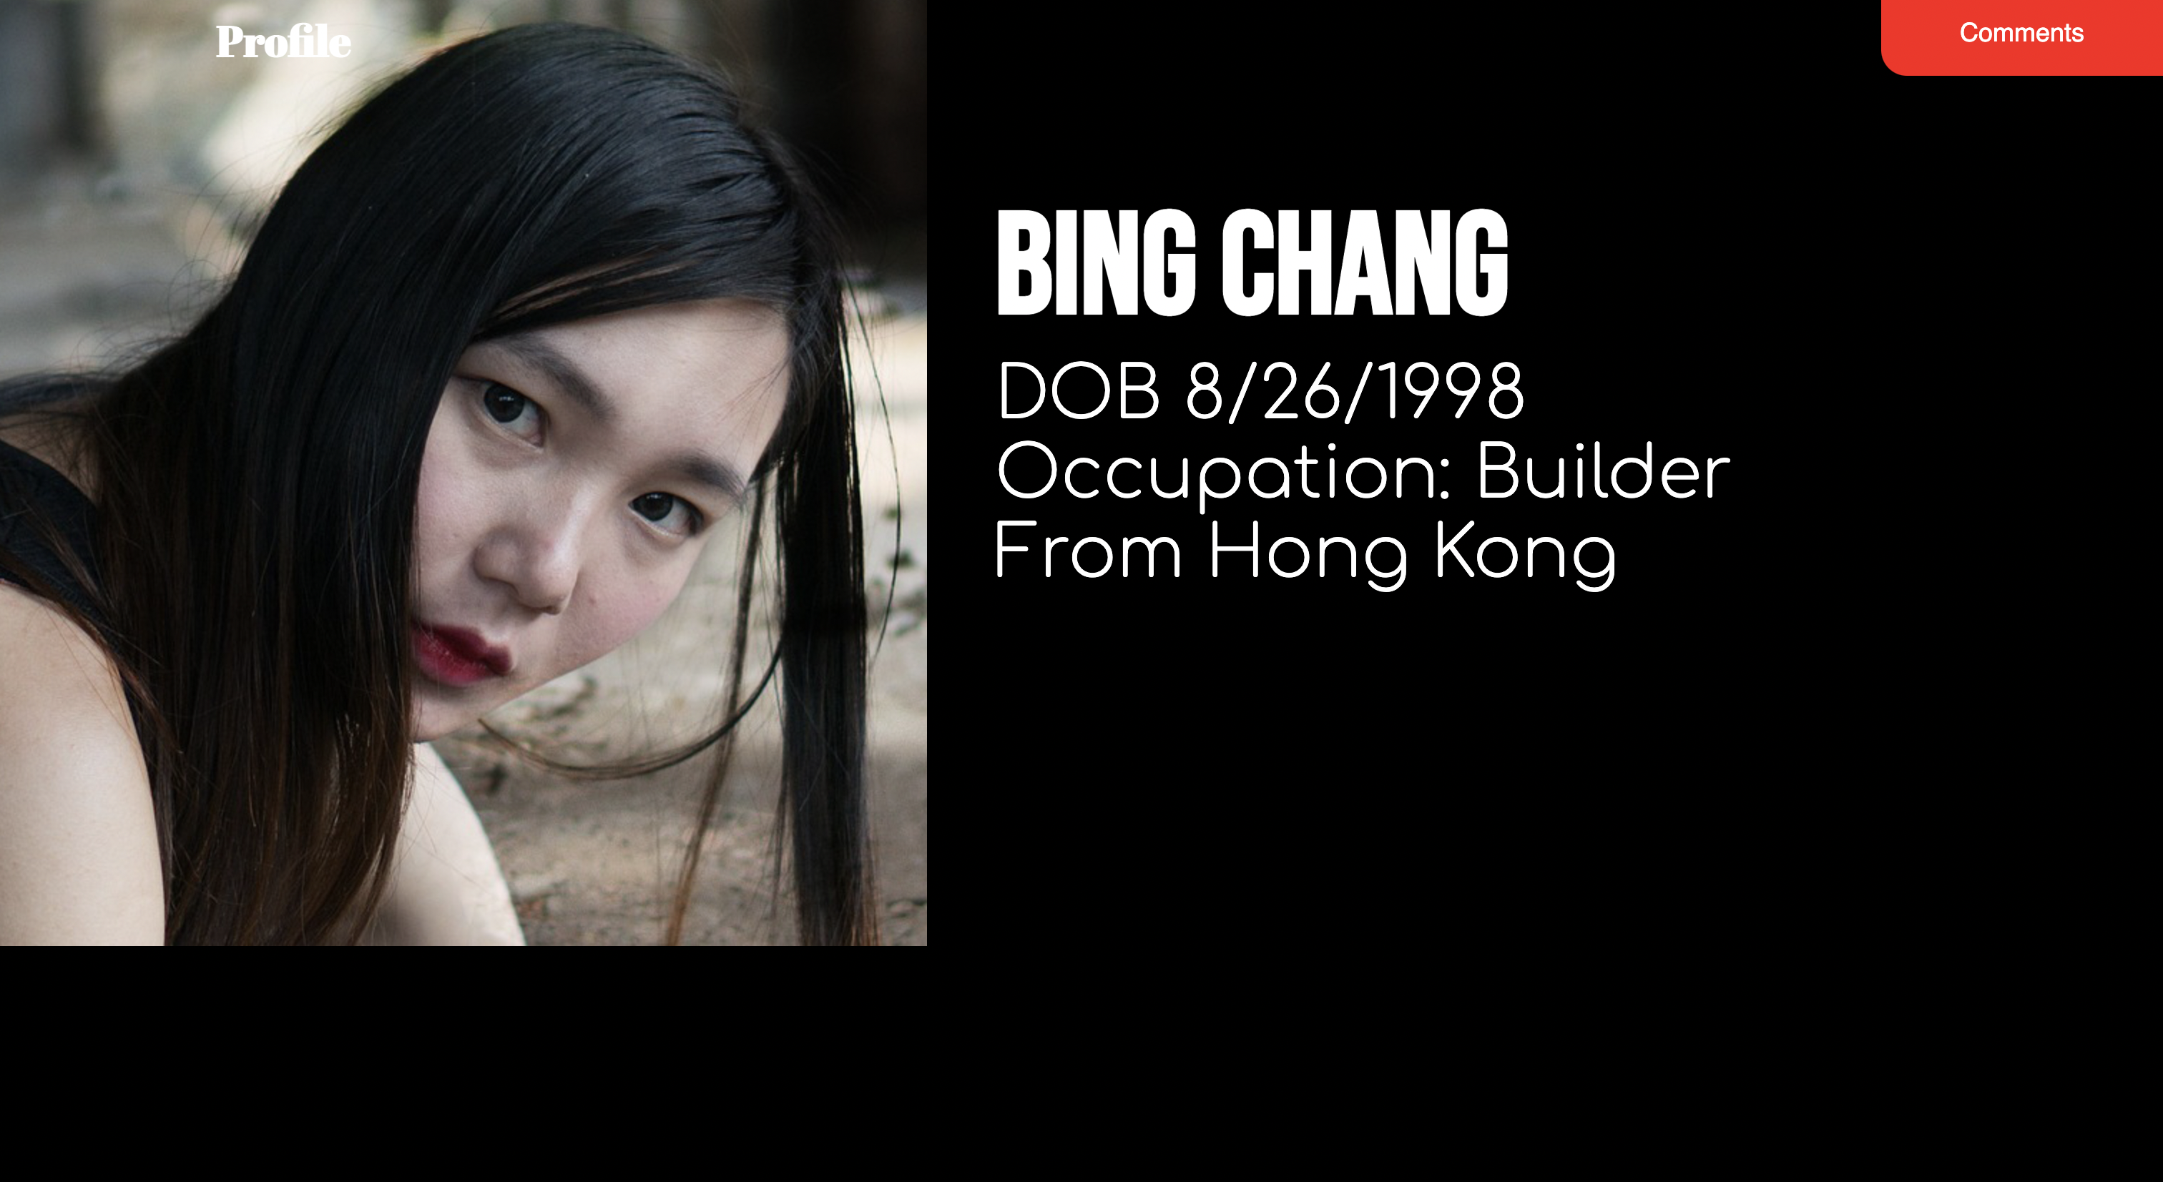
PROFILE

Slide 19
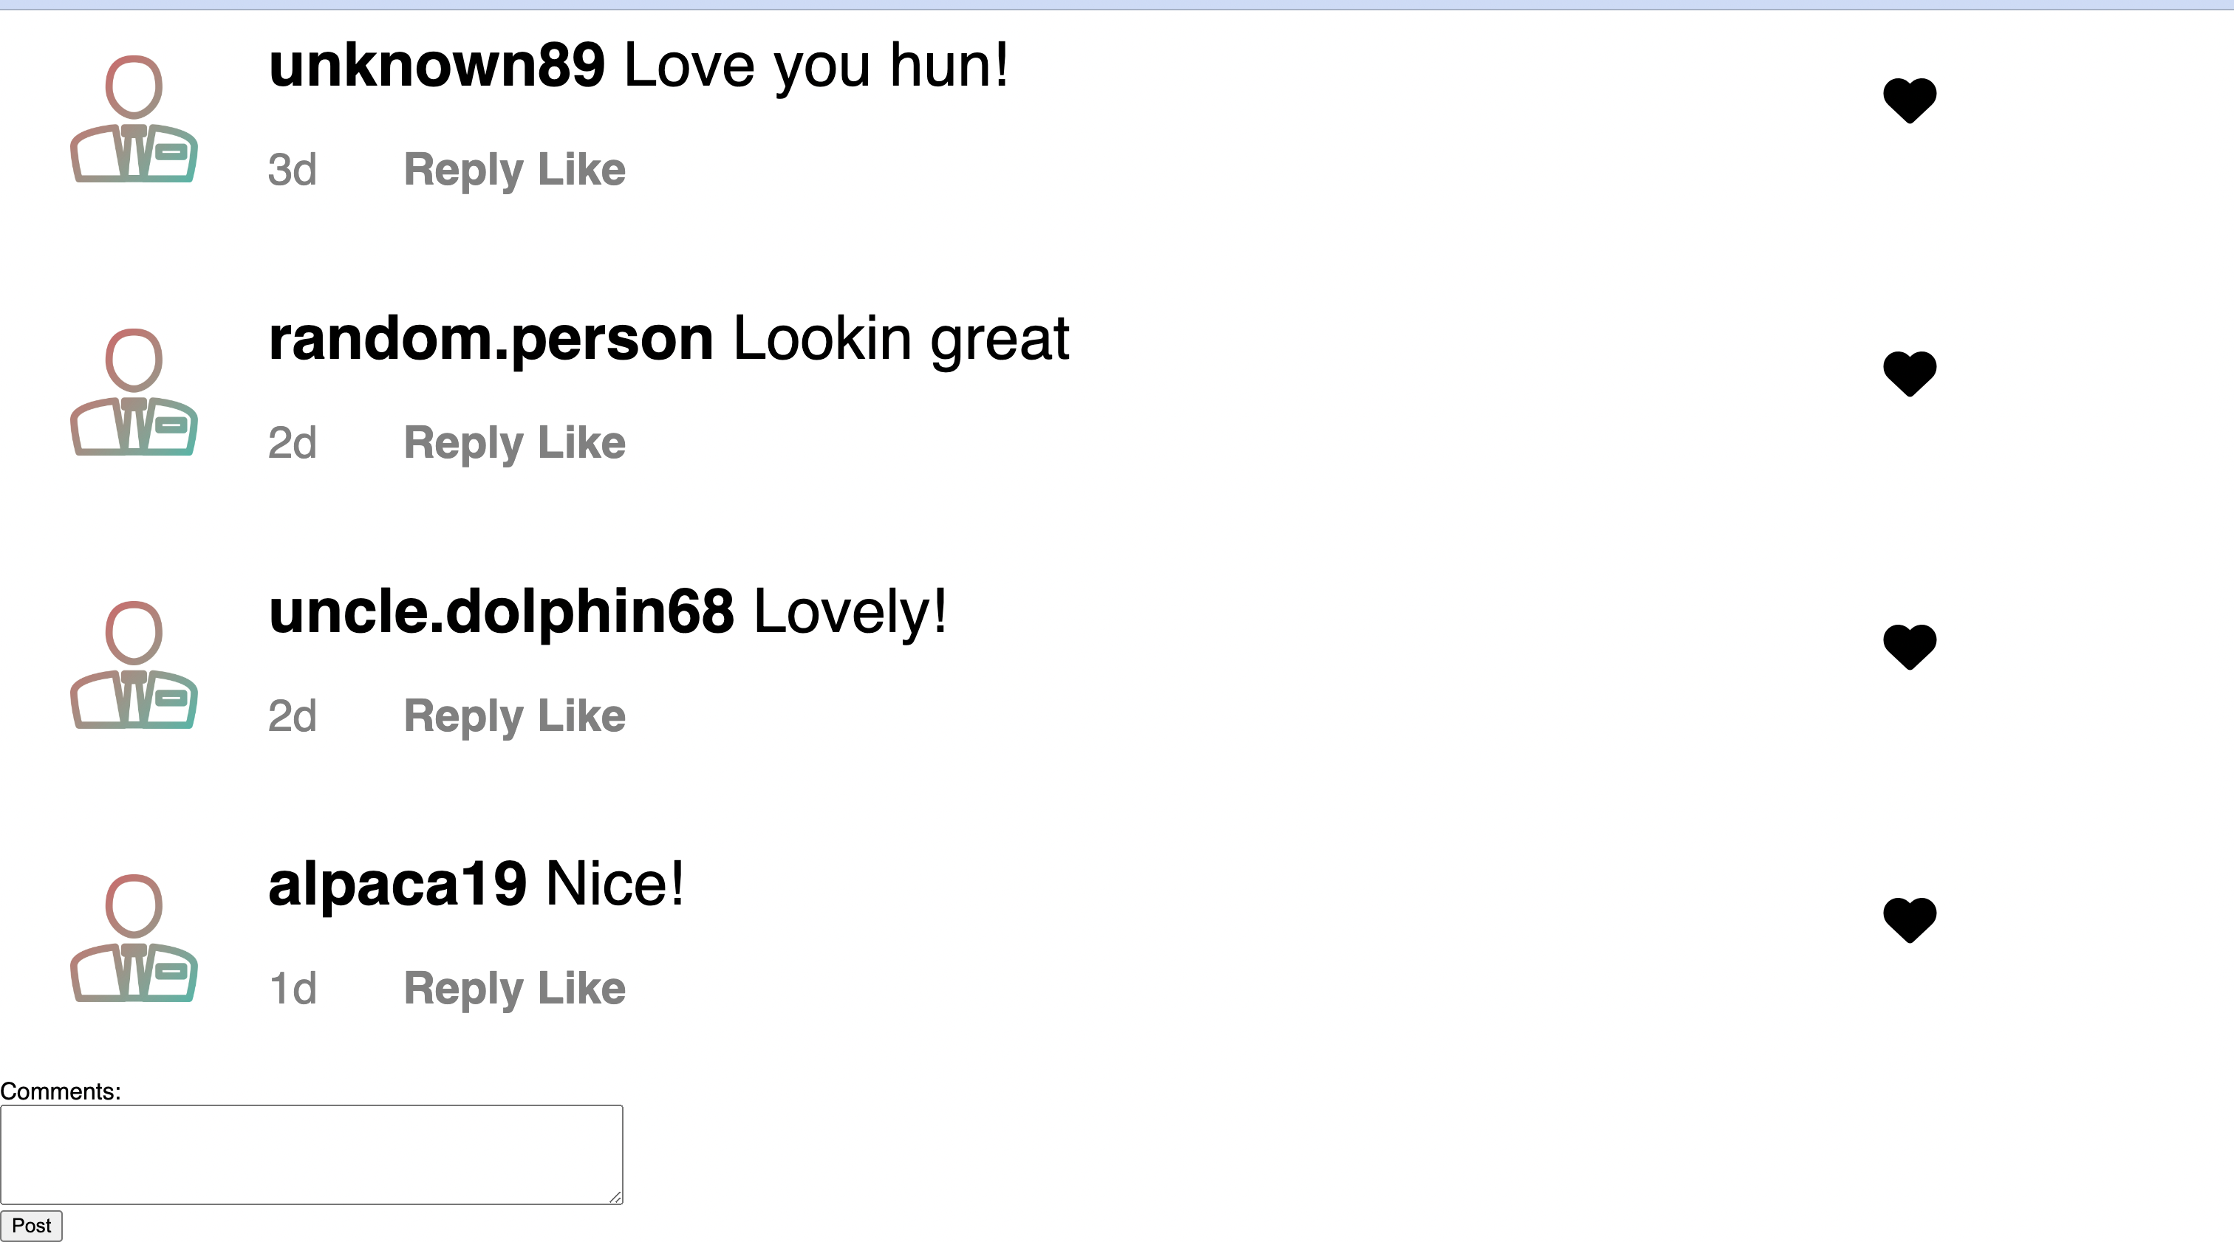
COMMENT SECTION

Slide 20
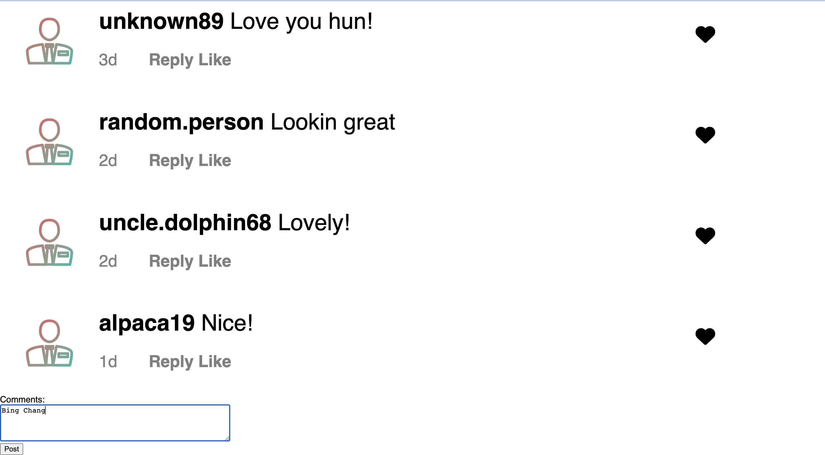
COMMENT SECTION

Slide 21
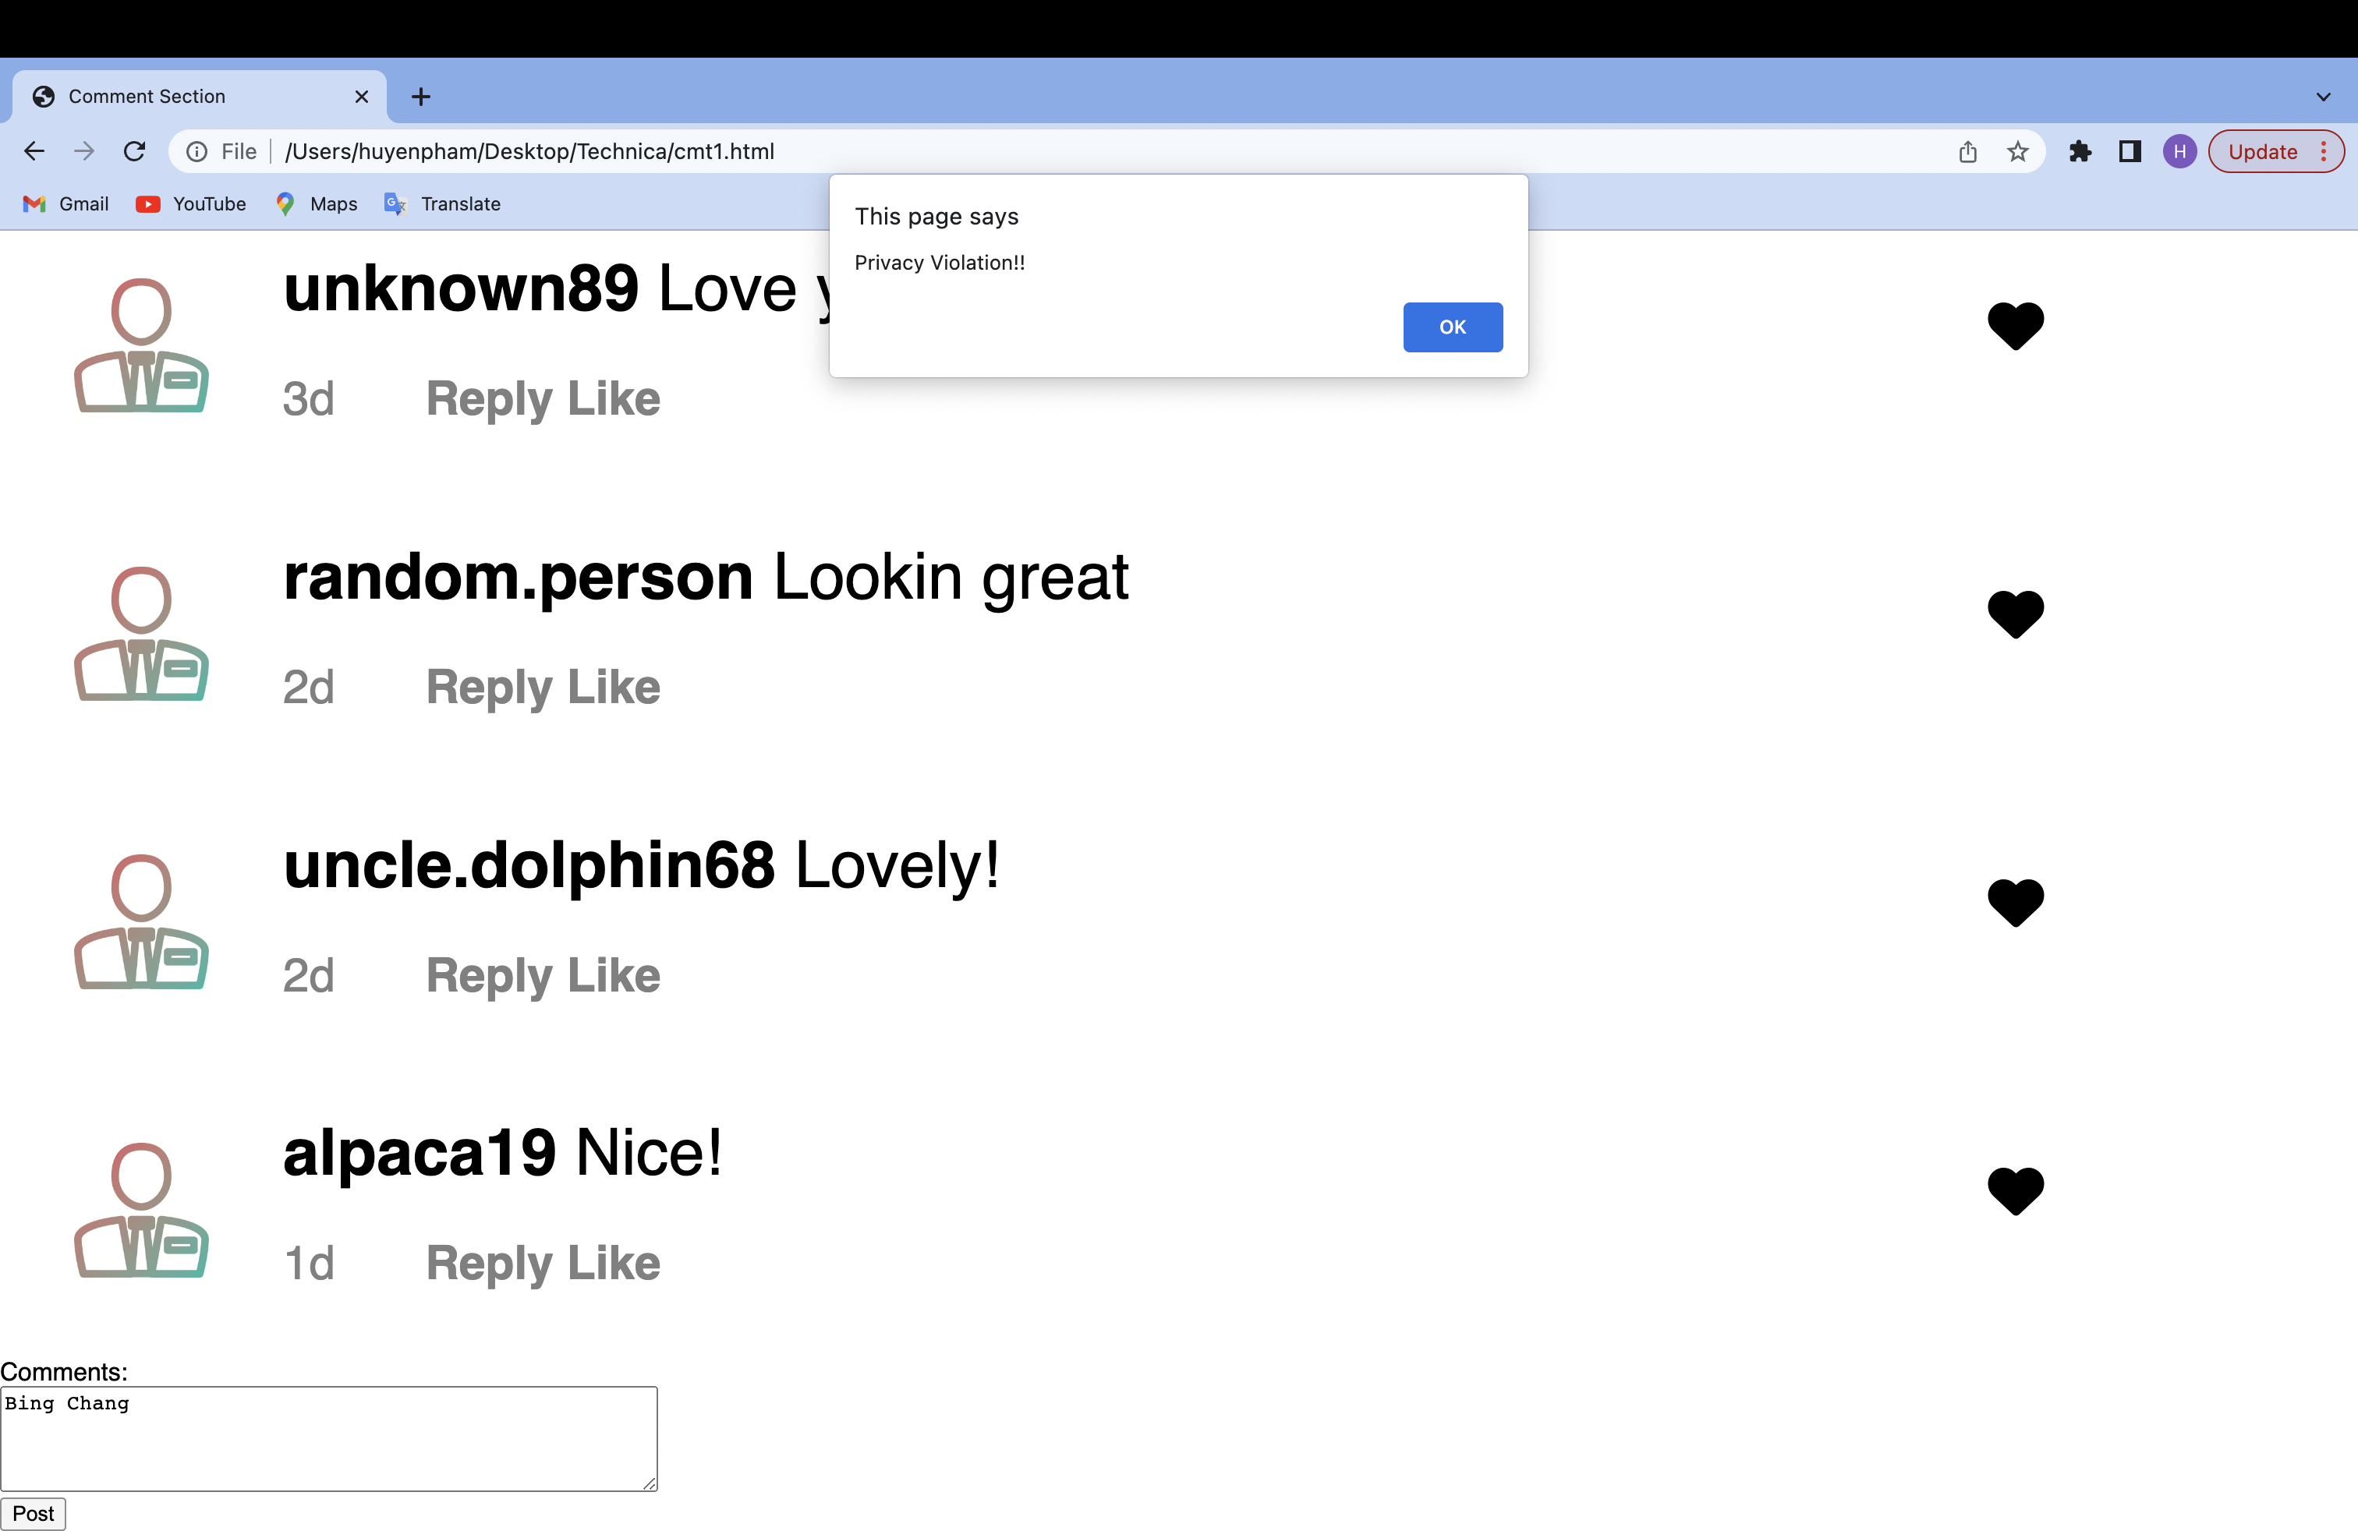
ALERT

Slide 22
05
INCOMPLETE PROJECT?

Slide 23
YES
Reason:
We haven’t covered all possible inputs.
These are only basic informations.
We only gather information of 5 people.
There are many more ways to get users’ information.

Slide 24
06
OUR FEELINGS

Slide 25

INCOMPLETE BUT STILL HAVE GROUND TO GROW

Slide 26
THANK YOU
TECHNICA!
Notes:
Thank you for giving us the chance to connect, to learn and to grow!

